Slide 1

TO-DO APP
Group: Sang Nguyen & Haiqa Noor

Slide 2


Project Aim & Overview
Objective: Develop a secure web-based To-Do application.
Users can register, log in, and manage tasks securely.
Main Features:
- Secure user authentication and session handling
- Task management with CRUD operations
- Focus on secure programming principles
Backend
Python, Django
Django REST Framework
PostgreSQL, Docker

Slide 3


Tools and Frameworks Used
Backend
Python, Django
Django REST Framework
PostgreSQL, Docker
Security Libraries
Frontend
- React, TypeScript
- Axios, React Query
- djangorestframework-simplejwt
- django-ratelimit
- django-cors-headers

Slide 4
Tools and Frameworks Used
Backend
Security Libraries
- djangorestframework-simplejwt
- django-ratelimit
- django-cors-headers
Python, Django
Django REST Framework
PostgreSQL, Docker
Frontend
- React, TypeScript
- Axios, React Query

Slide 5
Tools and Frameworks Used
Backend
Security Libraries
Frontend
- React, TypeScript
- Axios, React Query
- React-hook-form
- MUI library
- djangorestframework-simplejwt
- django-ratelimit
- django-cors-headers
Python, Django
Django REST Framework
PostgreSQL, Docker

Slide 6

Secure Programming Implementations
Backend:
- JWT authentication with access/refresh tokens
- CSRF protection via middleware
- SQL injection prevention using ORM
- Strong password hashing (PBKDF2)

Slide 7
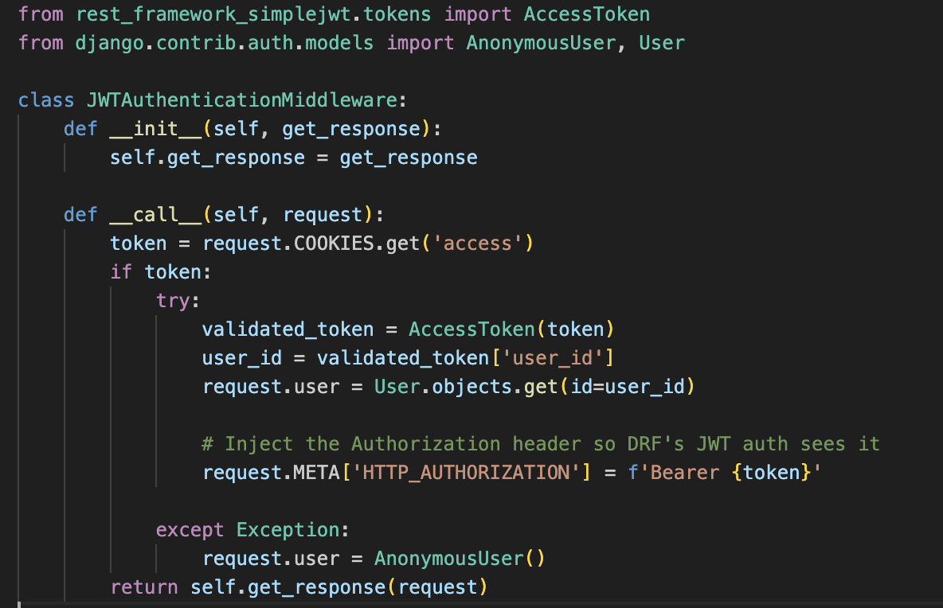
Secure Programming Implementations

Slide 8
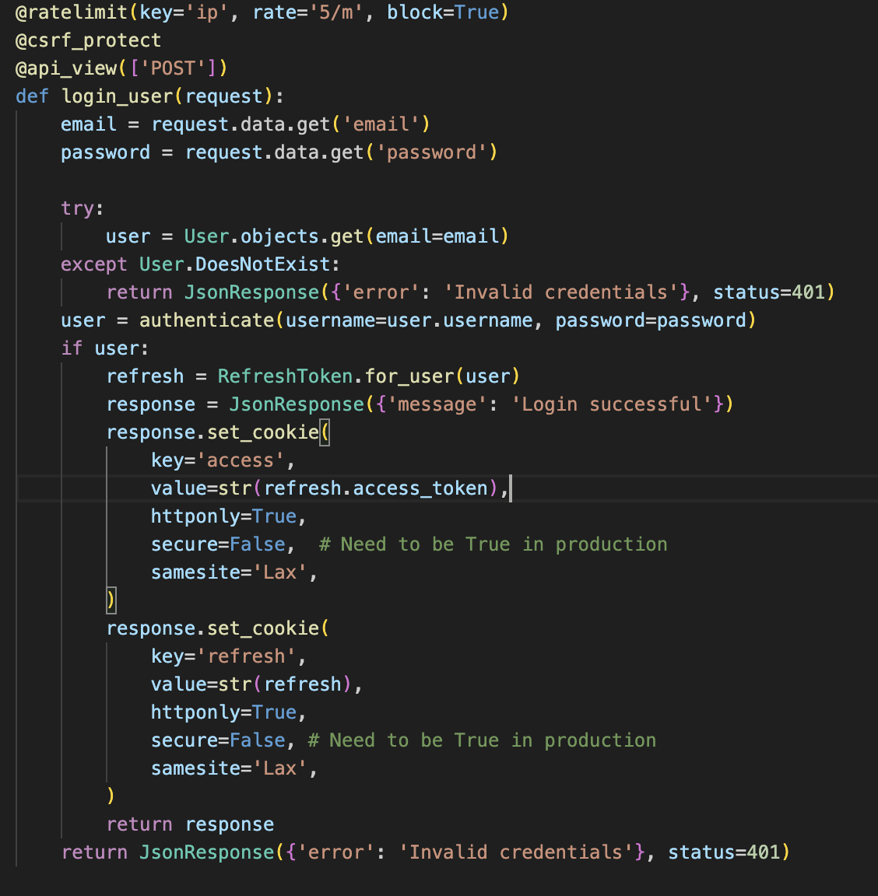
Secure Programming Implementations

Slide 9

Secure Programming Implementations
Frontend:
- Input validation to prevent XSS
- JWT tokens handled in HttpOnly cookies
- Role-based access UI restrictions

Slide 10
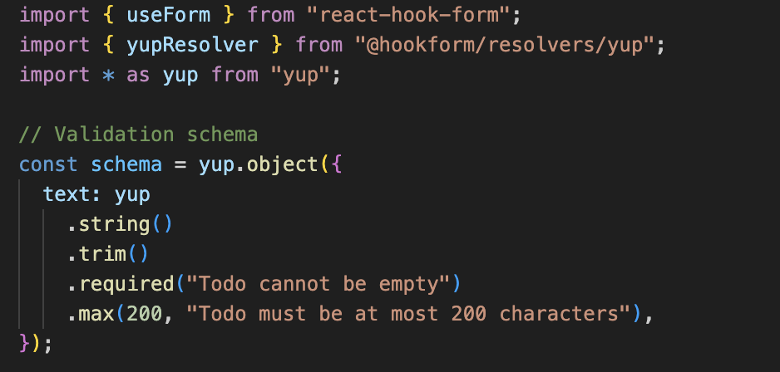
Secure Programming Implementations

Slide 11
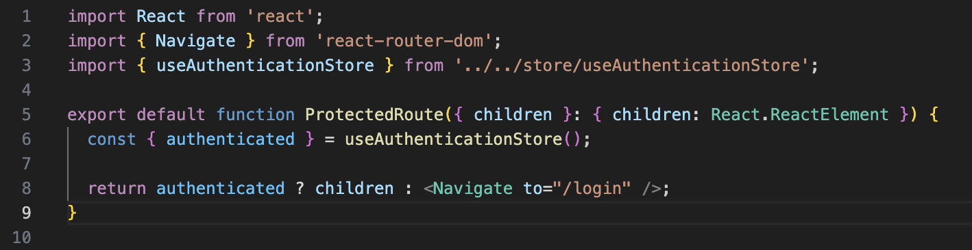
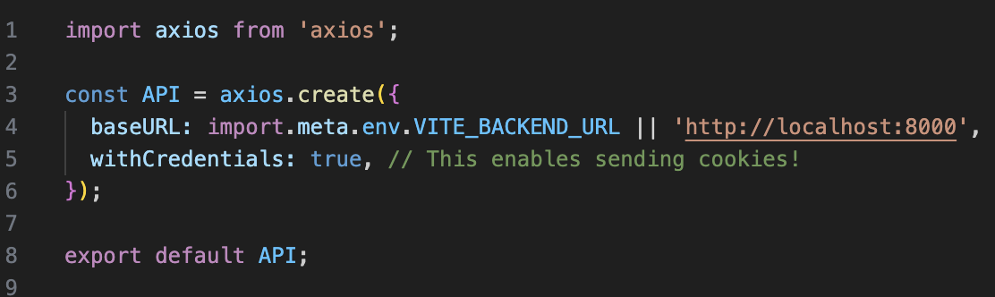
Secure Programming Implementations

Slide 12
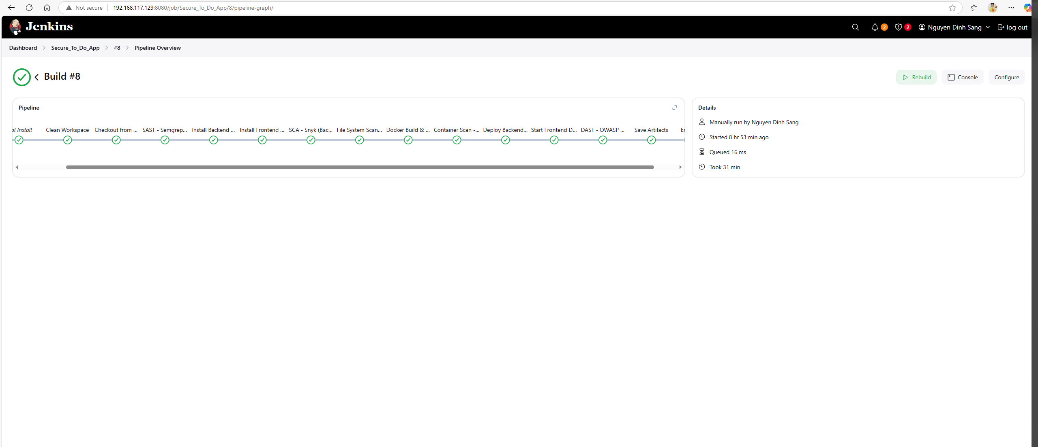
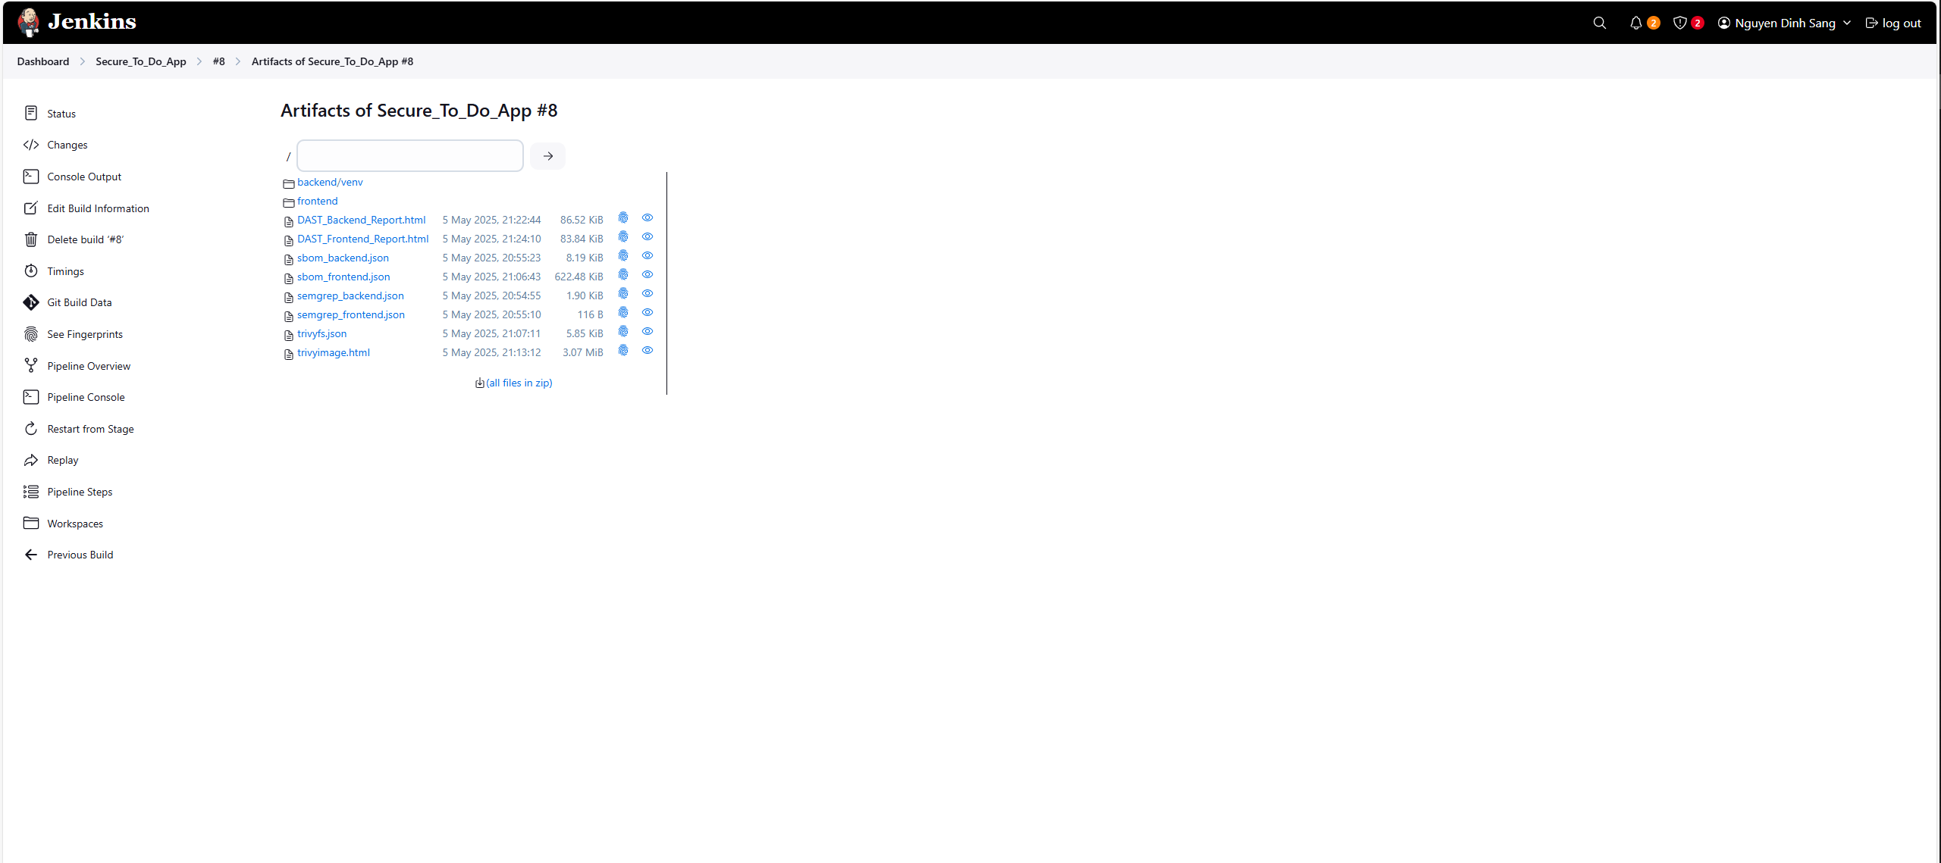
Testing & Results

Slide 13

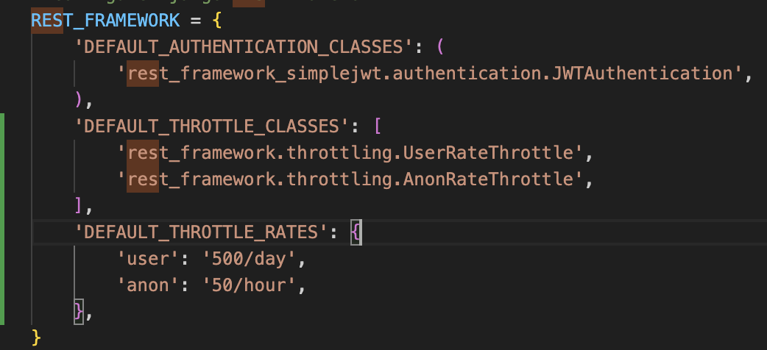
Testing & Results
SAST – Static Application Security Testing
Frontend: No issue found
Backend: missing throttling configuration
Solution: Add Django REST Framework
throttling settings and Django_ratelimit

Slide 14


Testing & Results
SCA – Software Composition Analysis
Generate SBOM for backend and frontend
For frontend, snyk tested 110 dependencies
for known issues, no vulnerable paths found.
snyk

Slide 15
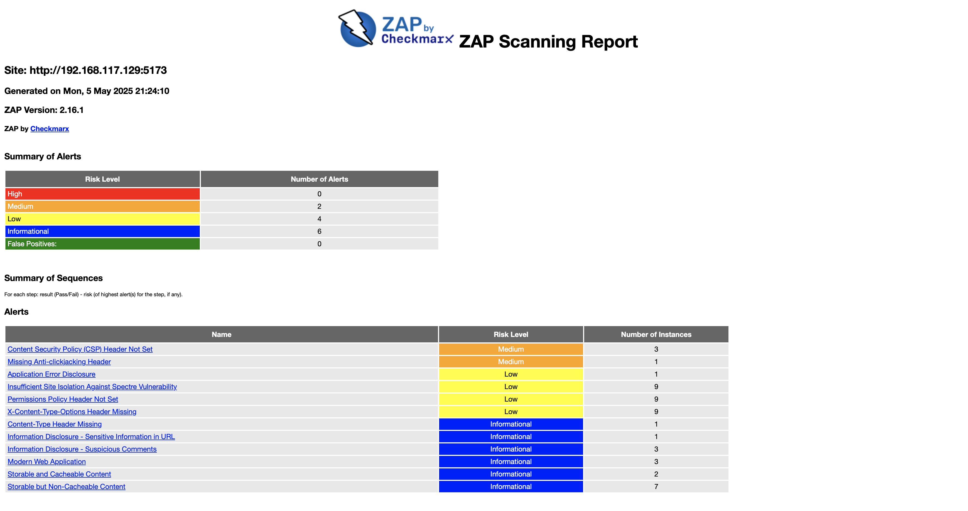

Testing & Results
DAST – Dynamic Application Security Testing

Slide 16
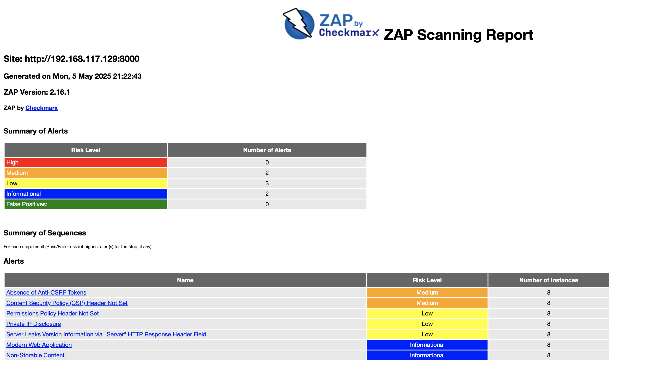
Testing & Results
DAST – Dynamic Application Security Testing

Slide 17
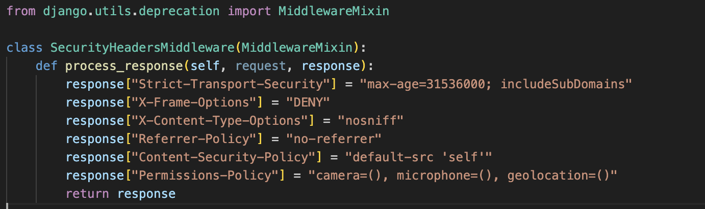
Testing & Results
DAST – Dynamic Application Security Testing

Slide 18

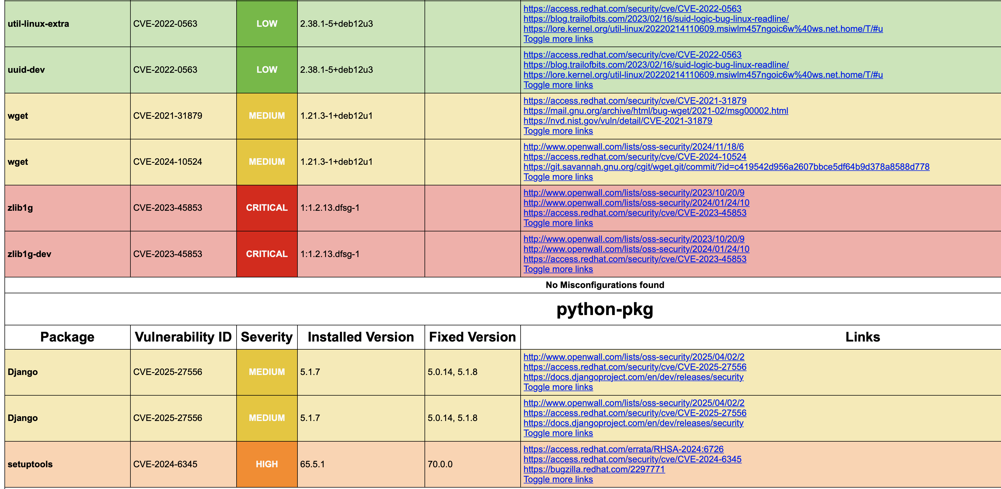
Testing & Results
Trivy File System & Container Scanning:

Slide 19
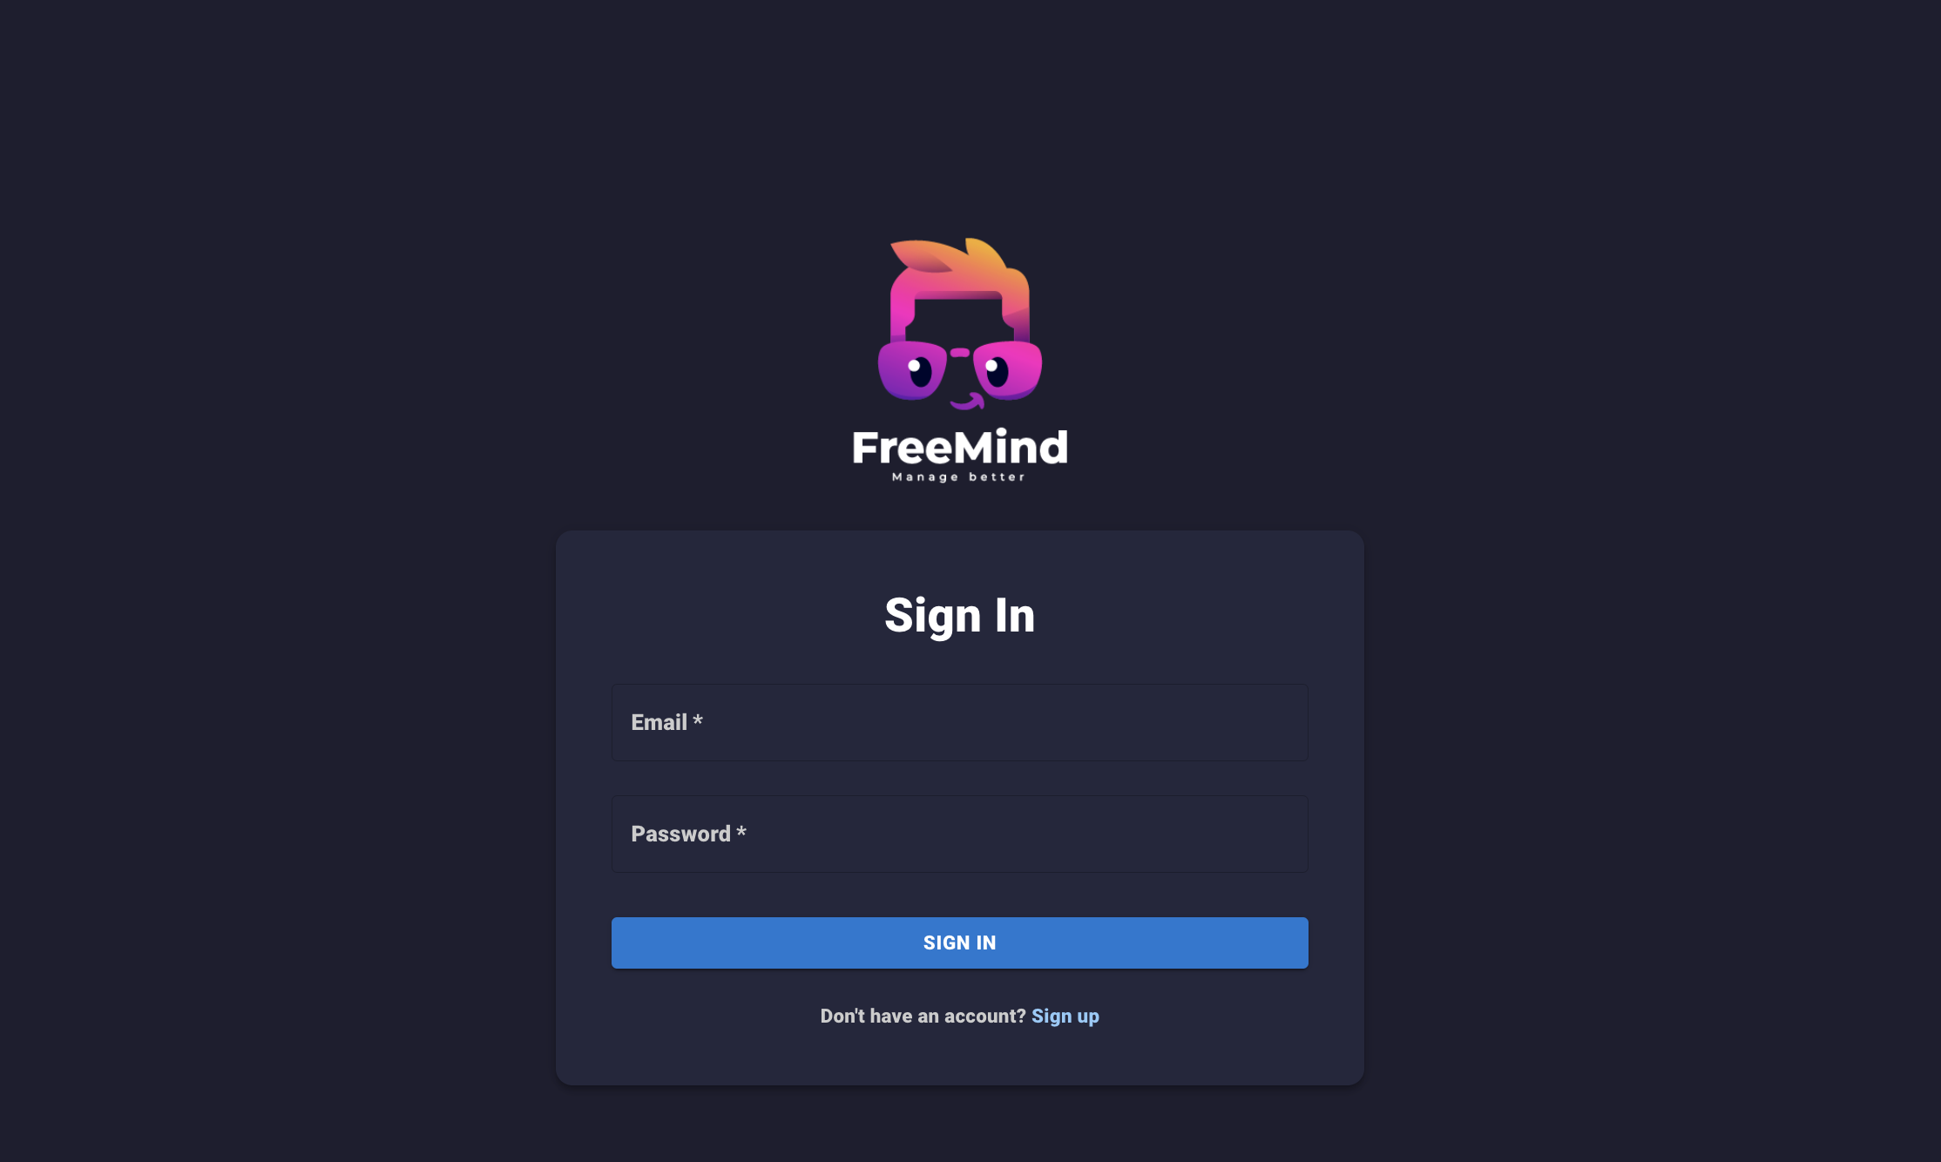
Application Demo

Slide 20
Thank you for listening

